Slide 1
Understanding customers’ opinions through
natural language processing
MSBA Machine Learning Project
Team 3 | Derek Huang, Aman Jiddewar, Mira Stefanova, Katie Wallis
8 April 2019

Slide 2
Today’s Agenda
We used Topic Modeling to understand the important features of the Amazon Kindle Fire
Problem Overview
Data Preparation
Next Steps & Questions
Topic Modeling
Topic Interpretation & Senitments

Slide 3
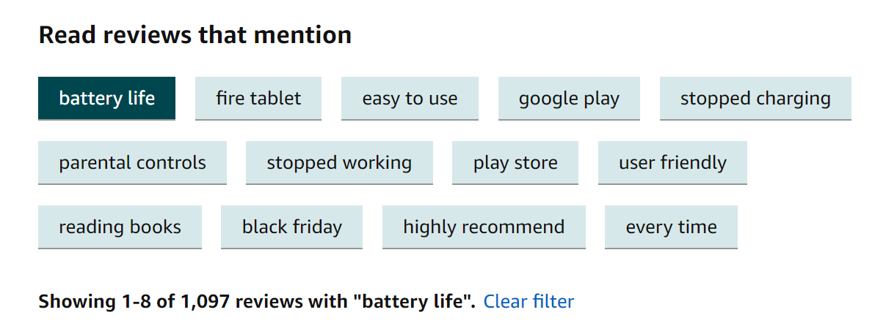
Filter Amazon Reviews by the Topic You’re Interested In
For Amazon’s most popular products there are thousands of reviews; Customers need to filter through the noise.
Currently, Amazon uses 2-Grams to discover the most mentioned words in reviews
Some of the N-Grams aren’t great filters…
Instead, Amazon could use topic modeling to filter reviews!

Slide 4
We used Text Mining on Amazon Reviews to prepare the data for analysis
Filter Reviews for Kindle
(160M reviews in public S3)
Natural Language Processing
Topic modeling and Sentiment Analysis
Kindle Family has 596 reviews
Average Review Rating: 4.05
(Filtering done with AWS Athena)
Reviews tokenized
Stop-, common-, short- and long- words removed
Words stemmed
Only nouns, adjective and verbs used
Discovered underlaying topics
Extracted Positive, Negative and Neutral Sentiments
(using NLTK package)

Slide 5
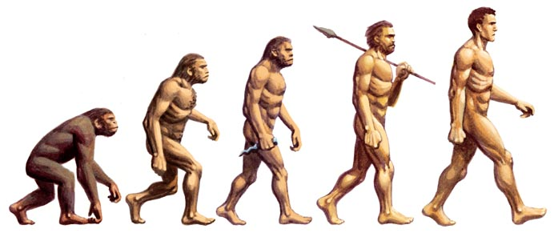
We compared side-by-side three different topic modelling approaches for the task of discovering underlaying topics
Latent Semantic Analysis
(LSA)
Probabilistic Latent Semantic Analysis
(PLSA)
Latent Dirichlet Allocation
(LDA)
TRAINING SPEED
TRAINING SPEED
TRAINING SPEED
90%
85%
70%
ACCURACY
ACCURACY
ACCURACY
60%
70%
85%
INTERPRETABILITY OF RESULTS
INTERPRETABILITY OF RESULTS
INTERPRETABILITY OF RESULTS
70%
80%
90%
Source: “Topic Modeling with LSA, PLSA, LDA & lda2Vec”, Joyce Xu, Medium.com

Slide 6
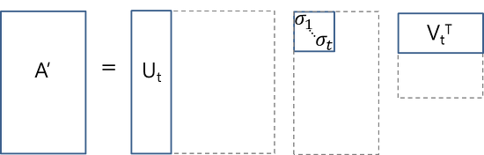
Core Idea
Take a matrix of what we have — documents and terms — and decompose it into a separate document-topic matrix and a topic-term matrix.
Main Positive Aspect
- Quick and efficient to use
Shortcomings
Lack of interpretable embeddings (we don’t know what the topics are, and the components may be arbitrarily positive/negative)
Need for really large set of documents and vocabulary to get accurate results
Less efficient representation
Topic Results
Number of topic (based on coherence score): 3
Battery: 0.519*"buy" + 0.271*"charge" + -0.256*"app" + -0.245*"screen" + -0.231*"issue" + 0.166*"work" + 0.165*"charger" + -0.131*"store" + -0.125*"want" + 0.122*"love"
Screen: 0.019*"product" + 0.019*"buy" + 0.012*"page" + 0.010*"screen" + 0.009*"turn" + 0.009*"game" + 0.009*"price" + 0.008*"click" + 0.008*"app" + 0.007*"touch"
Latent Semantic Analysis
Source: “Topic Modeling with LSA, PLSA, LDA & lda2Vec”, Joyce Xu, Medium.com

Slide 7
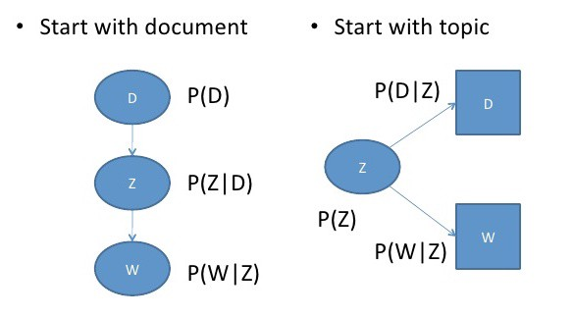
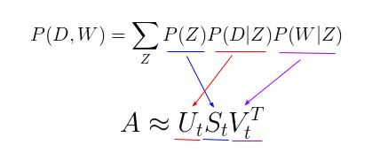
Core Idea
Find a probabilistic model with latent topics that can generate the data we observe in our document-term matrix
Main Positive Aspect
- More flexible model which adds a probabilistic treatment of topics and words on top of LSA
Shortcomings
Because we have no parameters to model P(D), we don’t know how to assign probabilities to new documents
The number of parameters for pLSA grows linearly with the number of documents we have, so it is prone to overfitting
Topic Results
Number of topic: 5
Topic Table:
Probabilistic Latent Semantic Analysis
Price | Gift | Screen | Camera
Everything | read | love | Camera
hop | gift | print | look
offer | buy | think | take
money | use | recommend | picture
own | book | book | price
 | Christmas
……
Source: “Topic Modeling with LSA, PLSA, LDA & lda2Vec”, Joyce Xu, Medium.com

Slide 8
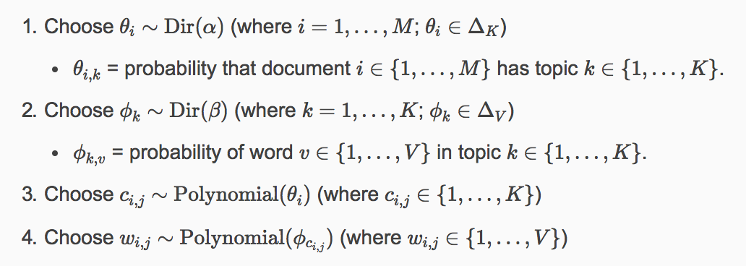
Core Idea
Bayesian version of pLSA which uses dirichlet priors for the document-topic and word-topic distributions.
* Dirichlet = “distribution over distributions”. Intuitive understanding: “Given this type of distribution, what are some actual probability distributions I am likely to see?”
Main Positive Aspects
Can generalize to new documents better than PLSA. Given a new document, we can obtain a vector representing its topic mixture.
The most popular and typically most effective topic modeling technique.
We can extract human-interpretable topics from a document corpus, where each topic is characterized by the words they are most strongly associated with.
Shortcomings
Still requires manual interpretation of the topics
Topic Results
Number of topic (based on coherence score): 6
Shipping: 0.017*"love" + 0.016*"problem" + 0.013*"product" + 0.013*"buy" + 0.011*"say" + 0.011*"use" + 0.010*"order" + 0.009*"charge" + 0.008*"receive" + 0.008*"day”’
Screen: 0.019*"product" + 0.019*"buy" + 0.012*"page" + 0.010*"screen" + 0.009*"turn" + 0.009*"game" + 0.009*"price" + 0.008*"click" + 0.008*"app" + 0.007*"touch"
Latent Dirichlet Allocation
Source: “Topic Modeling with LSA, PLSA, LDA & lda2Vec”, Joyce Xu, Medium.com

Slide 9
The results of all individual models were merged into a meta-model, delivering 5 final topics
LSA model
PLSA model
LDA model
Price
Screen
Battery
Screen / Readability
Screen
Shipping
Gift
Camera
 | Number of reviews | % positive sentiment | % negative sentiment
Screen | 297 | 0.184 | 0.0697
Purchasing Logistics | 353 | 0.178 | 0.0688
Gifts | 294 | 0.185 | 0.0641
Camera | 146 | 0.181 | 0.0652
Battery | 356 | 0.175 | 0.0691
Average | 289 | 0.180 | 0.0673

Slide 10
Kindles Best and Worst Features
Least Positive
Most Positive
B: Purchasing Logistics
B
Key insights:
A
Common
E: Gifts
A: Battery
Battery and purchase logistics are the least positive feature of the Kindles
E
D: Screen
D
Frequency of Mentions
Users rarely commend on the device’s camera (probably because only Kindle fire has a camera)
C: Camera
The screen and gifting are the most positive features of the Kindles
Uncommon
C
Overall low average positive sentiment of reviews across all topics – only 18% positive
Given the average negative sentiment of 0.067, the reviews are mostly neutral.
Average Positive Sentiment

Slide 11
We aspired to automatically generate the topic labels without human intervention
Potential solution to current challenge
We have to manual assign topic labels across millions of products. The following steps is a potential solution to automatically generate topic labels for product features:
Input data of each category of product (for example, reviews for all tablets) and used LSA and LDA to generate topics
Generating labels by associating each topic with 2-5 n-gram words (since n-gram captures nouns better, which can be used as attributes of the products), assign weights based on all the reviews under the n-gram words.
Rank each review based on the coefficients of terms for each topic-label
For both the topic label and review, create the helpful click so that customers can rate if the topic or the review is helpful.
Use the number of helpful clicks for topic to update weights for topic-labels and keep only the dominate labels.
Update the ranking score based on the number of helpful clicks for each review and re-rank reviews under each topic based on the score

Slide 12
If you’ve enjoyed this presentation don’t forget to share some love!
Thank you for your attention!
Are there any questions?

